Slide 1

Pawsible
A Secure and Organized Way to Manage Your Pet's Information
Team:
{ Quantum Cookie }
Category:
{ Open Innovation }

Slide 2
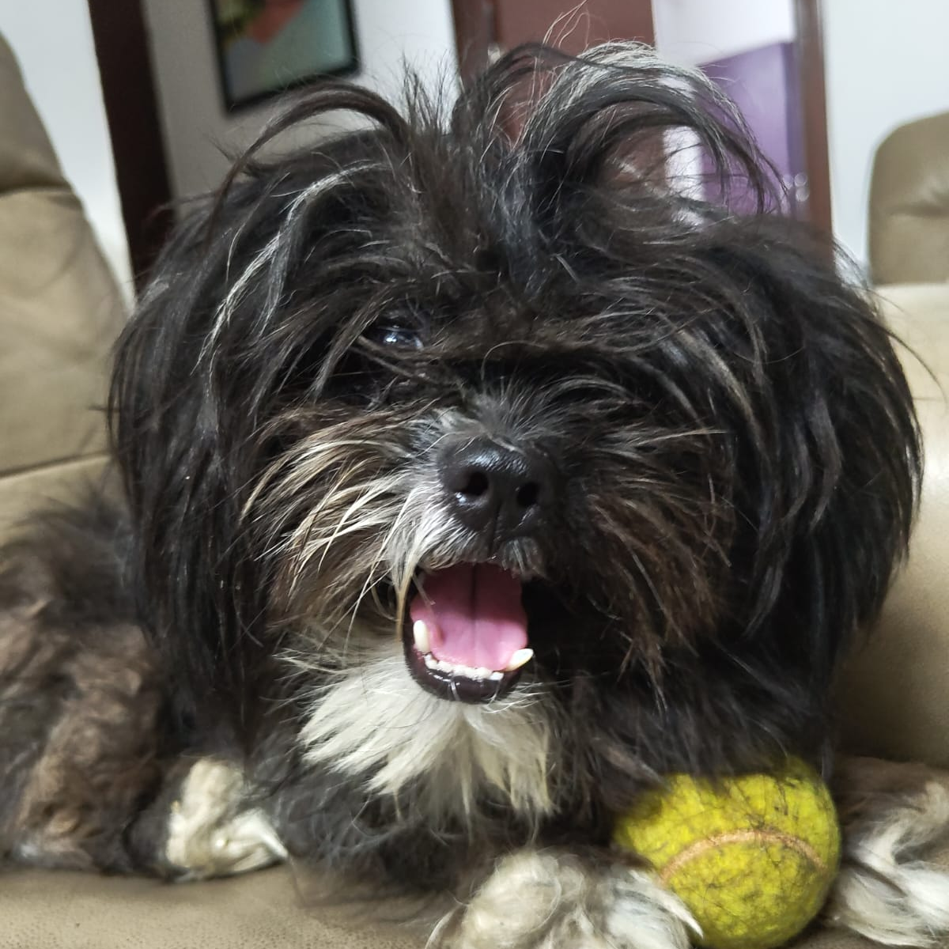
Pet owners have a hard time running around keeping track of their furry friends’ lives.
Taking care of pets is a lot more than just cuddles and playtime. We often struggle to keep track of essential information like certificates, vaccination records, and health details, which are scattered in various places, often in physical form. This can lead to missed vaccinations, delayed treatments, and challenges in sharing accurate information with vets or pet sitters. A simple, organized solution is needed to manage all these records in a reliable and accessible manner.

Slide 3

Solution - Centralized Pet Dashboard App
A centralized dashboard that allows pet owners to securely store and manage their pet's information, including verified certificates, vaccination records, health history, and other critical details.
This platform ensures that all pet-related information is easily accessible and organized in one place.
And some fun stuff like planning play dates and resort/spa bookings and treats.

Slide 4

Features of Pawsible
1. Secure storage of pet details (e.g., name, breed, age).
2. Verified vaccination records.
3. Health history tracking.
4. Notifications for upcoming vaccinations and health check-ups.
5. Easy sharing of pet information with vets or pet sitters.

Slide 5
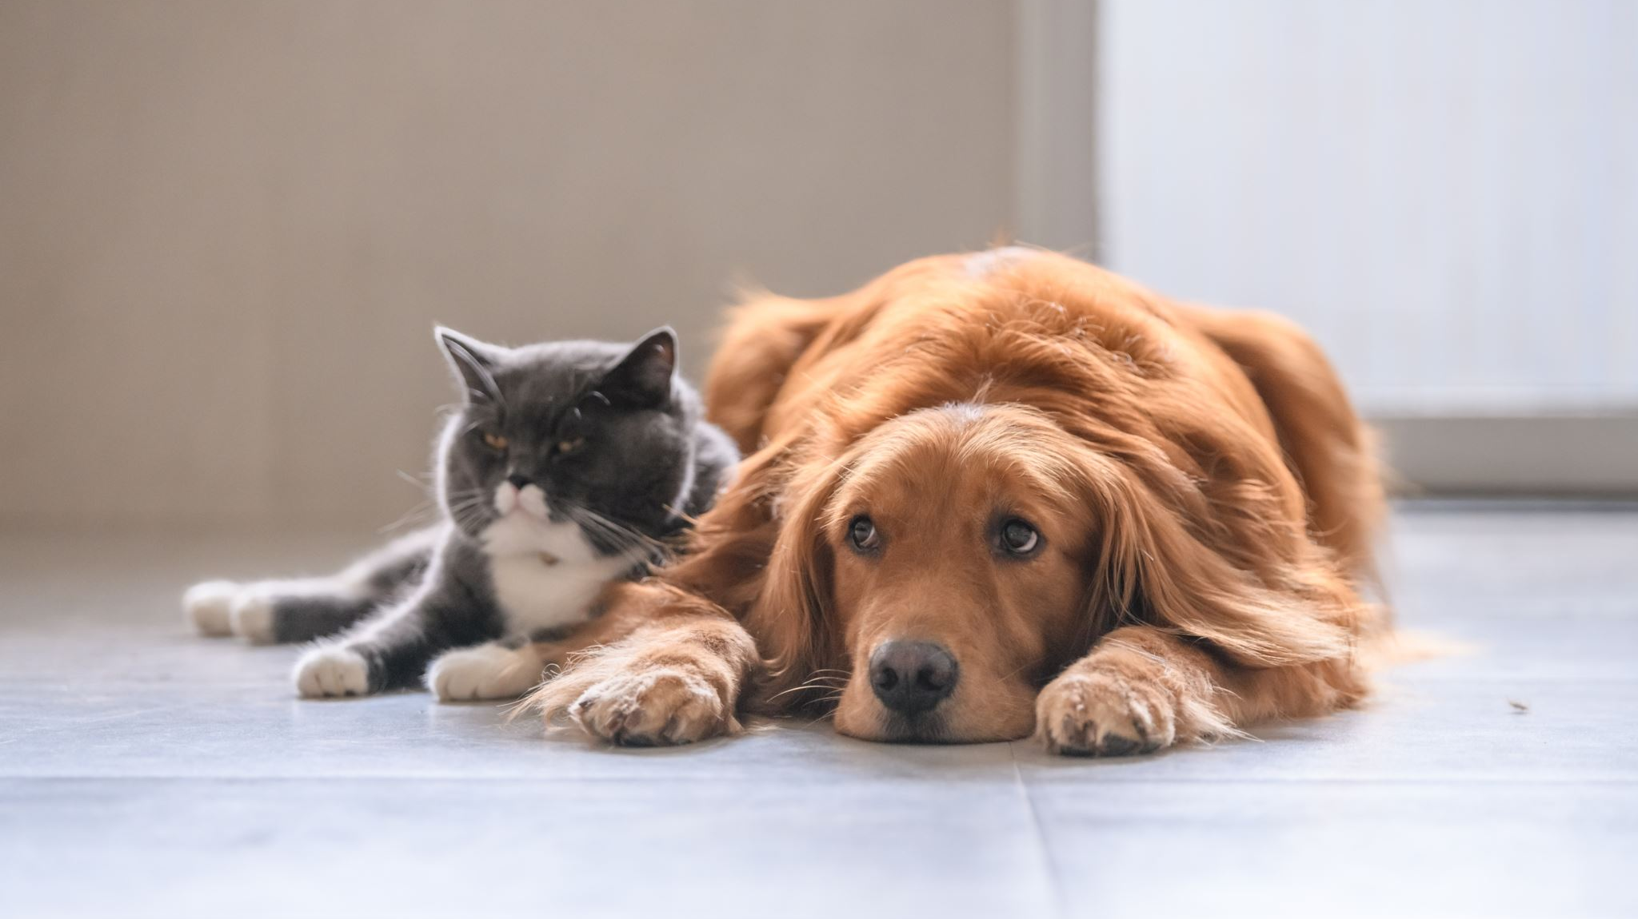
Conclusion
Pawsible provides a simple, effective solution for managing all your pet's important information in one secure, easy-to-use platform. With this tool, pet owners can ensure their pets receive the best care possible, with all records and details readily available when needed.

